Slide 1


The Importance of Physics in Spacecraft Design
Name : Farjan Ahmmed
Student ID : 0242320005341738
Section : A

Slide 2


Introduction
Spacecraft design is a complex and multifaceted process that requires a deep understanding of physics. From calculating the forces and stresses acting on the spacecraft to ensuring the proper functioning of its various systems, physics plays a crucial role in creating safe and efficient space vehicles.

Slide 3

Fundamental Laws of Motion and Their Application
Newton's Laws of Motion: Describing the relationship between force, mass and acceleration, these fundamental principles govern the movement of spacecraft through space.
Conservation of Momentum: Applying this law ensures spacecraft maintain stability and control during propulsive events.
Gravitational Interactions: Understanding the effects of gravity on spacecraft trajectories is crucial for accurate orbital calculations and mission planning.

Slide 4
Orbital Mechanics and Trajectory Planning
Calculating Orbital Trajectories
1
Spacecraft designers leverage Kepler's laws of planetary motion and Newton's laws of gravity to precisely calculate the optimal trajectory for a spacecraft to reach its intended orbit or destination.
2
Understanding Orbital Mechanics
Key factors like orbital velocity, eccentricity, inclination and period must be accounted for to ensure a spacecraft can successfully maneuver and maintain its orbit.
Optimizing Trajectory Planning
3
Trajectory planning involves simulations and models to minimize propellant usage, achieve the desired arrival time and account for gravitational effects from celestial bodies.

Slide 5
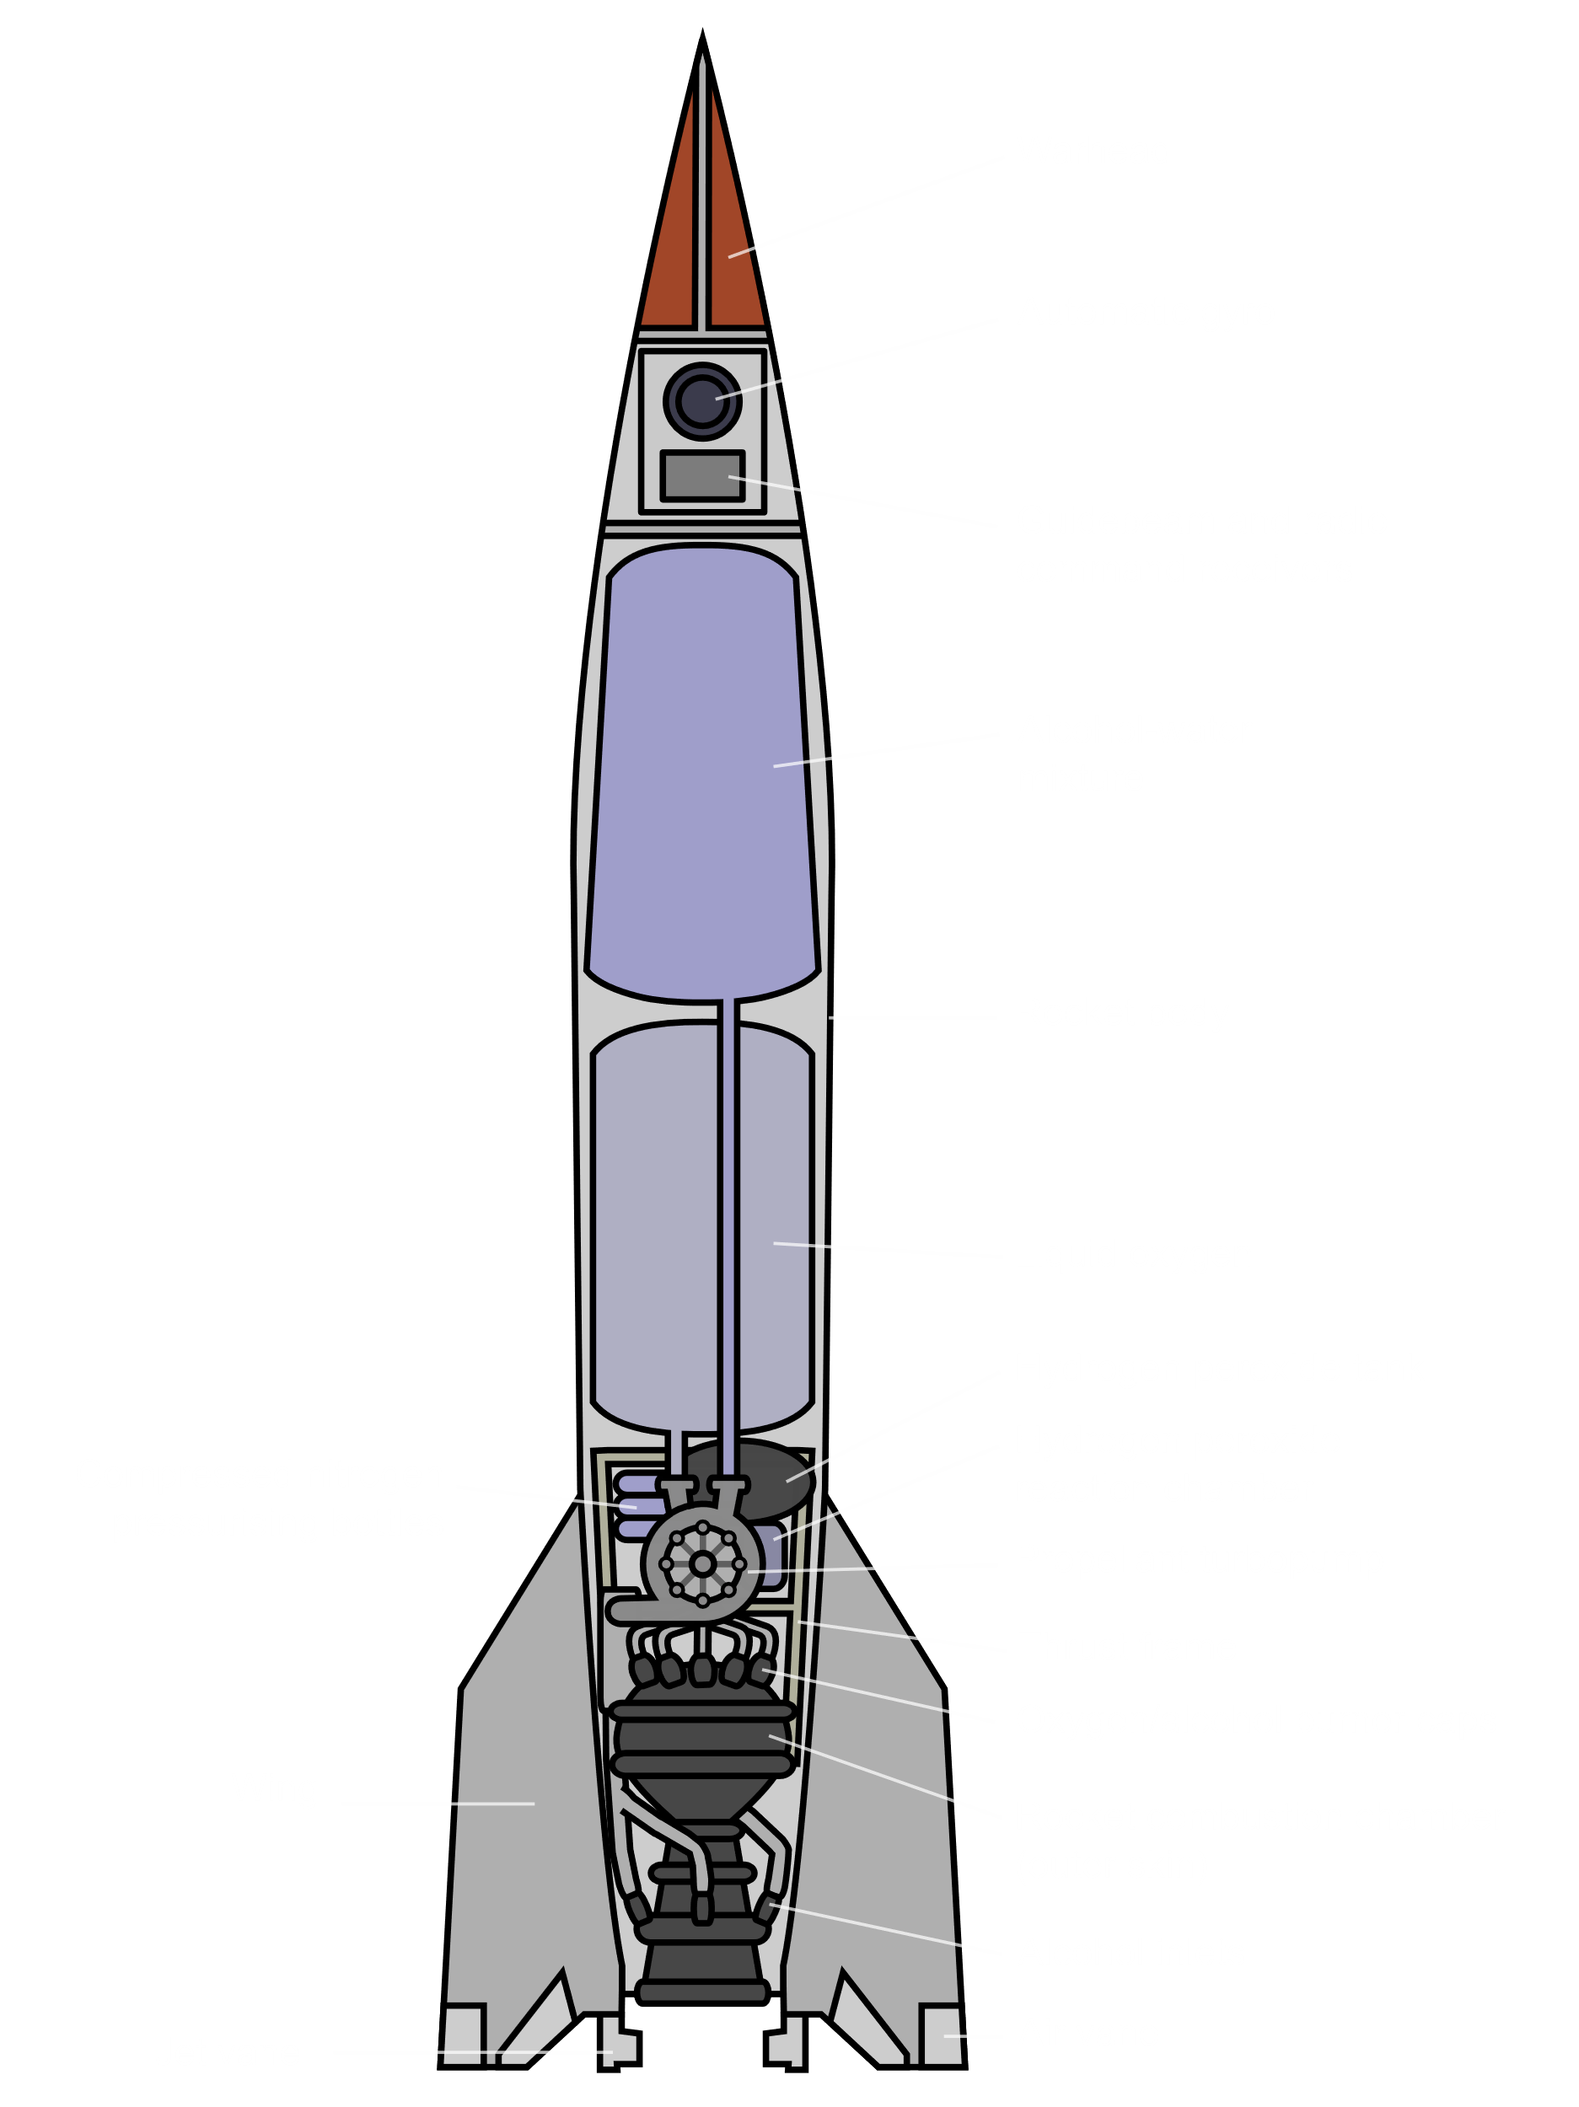
Propulsion Systems: Understanding the Physics
At the heart of any spacecraft's ability to travel through the vast expanse of space lies its propulsion system. These complex systems rely on fundamental principles of physics to generate the thrust required for launch, orbital maneuvers and deep-space exploration.
From chemical rockets to ion engines, the selection and design of a spacecraft's propulsion system must carefully consider factors such as energy efficiency, thrust-to-weight ratio and the behavior of propellants in the vacuum of space.

Slide 6

Aerodynamics and Atmospheric Effects
Spacecraft must overcome the challenges of aerodynamics and atmospheric conditions during launch and re-entry. Understanding principles like drag, lift and atmospheric density is crucial for efficient and stable flight.
Careful design of the spacecraft's shape and materials can minimize aerodynamic forces, enabling smooth ascent through the atmosphere and controlled re-entry into the Earth's atmosphere.

Slide 7




Structural Integrity and Material Selection
Strength and Durability
Thermal Resistance
Spacecraft must withstand immense forces during launch, travel and landing. Carefully chosen materials with high strength-to-weight ratios are critical for structural integrity.
Spacecraft encounter extreme temperature fluctuations. Materials must maintain their mechanical properties across a wide range, from the frigid vacuum of space to the heat of atmospheric re-entry.
Corrosion Resistance
Lightweight Design
Exposure to cosmic radiation, micrometeorites and chemically-reactive propellants demands materials that can withstand the harsh space environment without degradation.
Minimizing weight is crucial for launch efficiency and fuel economy. Advanced composite materials allow engineers to balance strength, durability and low mass.

Slide 8

Thermal Management and Heat Transfer
Effective thermal management is critical for the survival of spacecraft in the harsh environment of space. Understanding heat transfer principles, including conduction, convection, and radiation, is essential for designing efficient cooling systems to dissipate excess heat generated by onboard systems.
Proper material selection, insulation and active cooling techniques such as heat pipes and radiators are crucial to maintain optimal operating temperatures and prevent component failures. Integrating these thermal management strategies is a complex challenge that requires a deep understanding of physics and engineering principles.

Slide 9
Electrical Systems and Power Generation
Power Generation
Electrical Circuits
Wiring and Cabling
Energy Storage
Spacecraft rely on efficient power generation systems, often using solar panels, fuel cells or nuclear reactors to convert energy into usable electricity.
Careful design of electrical circuits is crucial to distribute power and transmit signals throughout the spacecraft, ensuring reliable operations.
Lightweight yet durable wiring and cabling are essential to connect the various electrical components and subsystems on a spacecraft.
Onboard batteries and other energy storage devices provide power during periods when the primary sources are unavailable, such as during eclipses.

Slide 10


Physics Based Sensors and Instrumentation
Spacecraft are equipped with a vast array of sensors and instrumentation to monitor and measure various physical phenomena. From accelerometers that detect motion to spectrometers that analyze the composition of distant objects, these instruments rely on fundamental principles of physics to function.
The design and placement of these sensors must carefully consider factors such as electromagnetic interference, thermal management and the harsh environment of space. Sophisticated algorithms are used to process the raw data and convert it into meaningful information for mission control.

Slide 11
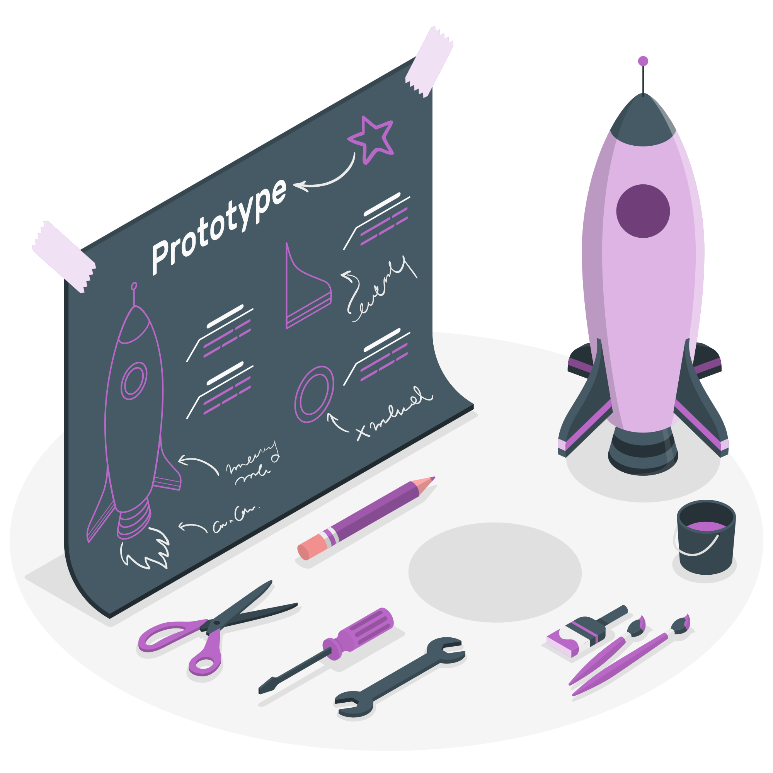
Conclusion : Integrating Physics Principles for Successful Spacecraft Development
In the design and engineering of spacecraft, the seamless integration of physics principles is paramount. By deeply understanding the fundamental laws of motion, orbital mechanics and various physical phenomena, spacecraft engineers can create innovative solutions that push the boundaries of space exploration.

Slide 12

Thank You

